Slide 1

Loan Approval Prediction Using Machine Learning
Team Members Details
S. Anvesh – 21N31A6750
T. Mokshith – 21N31A6755
V. Gouthami – 21N31A6761
III Year B.Tech-I Semester – CSE (Data Science)
Under the Guidance of
Dr. I Nagaraju
Professor & Dept. of ET
MRCET CAMPUS (UGC AUTONOMOUS INSTITUTION)
B.Tech III Year – I Sem | Application Development – I | External Project Review

Slide 2
Abstract
The prediction of loan approval and risk assessment is a critical task in the financial sector, as it directly impacts the stability of lending institutions and the financial well-being of individuals.
The project begins by collecting and preprocessing a dataset of historical loan data, including applicant information, loan terms, and credit history.
Several machine learning algorithms, including logistic regression, decision trees, random forests, and gradient boosting, are implemented and compared for their performance in predicting loan outcomes.
Additionally, the project explores the use of alternative data sources, such as social media activity and online behavior, to enhance the predictive power of the models.
The outcomes of this research provide valuable insights into the application of machine learning in the financial sector, contributing to the ongoing effort to optimize loan approval processes while minimizing the risk associated with lending activities.

Slide 3
Introduction
However, the traditional methods for evaluating the creditworthiness of loan applicants have often been fraught with challenges such as subjectivity, time-consuming manual assessments, and the potential for human bias.
This project, titled "Loan Prediction Using Machine Learning," is a timely exploration of the intersection between finance and artificial intelligence.
It delves into the application of machine learning algorithms to streamline the loan approval process, enhance its accuracy, and reduce the associated risks.
We also offer a glimpse into the goals and objectives of this project, emphasizing the potential for machine learning to transform the landscape of lending and borrowing, paving the way for a more robust, efficient, and just financial system.

Slide 4
Proposed System
The proposed system for "Loan Prediction Using Machine Learning" is a comprehensive solution that uses machine learning models, data analytics, and alternative data sources to improve loan evaluation.
The system includes data collection and preprocessing, feature engineering, machine learning models, performance evaluation, and the integration of non-traditional data sources.
Data preprocessing techniques will be employed to clean, transform, and normalize the dataset, while feature engineering will create relevant features from raw data.
Machine learning models will be trained on historical data to predict loan approval or rejection based on applicant attributes.
Continuous monitoring and improvement will be integral to the system's maintenance, responding to changing data trends and economic conditions.

Slide 5
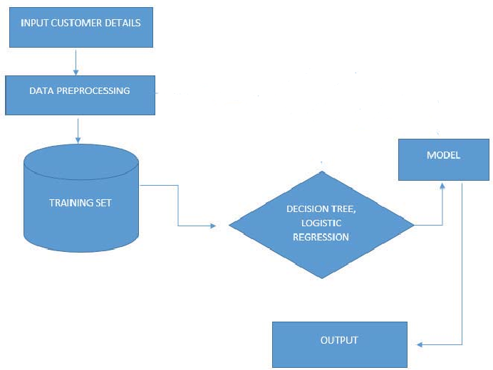
System Architecture

Slide 6
Software Requirements Specification (SRS)

Slide 7
Software Requirement Specifications (SRS)
Python 3.x
Required Python libraries: pandas, scikit-learn, joblib, numpy, tkinter
Provide a GUI using Tkinter for user input of loan application details.
Display the loan approval prediction result.
Machine Learning Models
The system uses the following machine learning models:
- Logistic Regression
- Support Vector Machines
- Decision Trees
- Random Forests.

Slide 8
Hardware Requirement Specifications (HRS)
Recommended Hardware Requirements
Operating System: Windows,MacOS, Linux
Processor
8 GB of RAM.
3.3 Storage
20 GB or more of free disk space.
3.4 Display
A monitor with a resolution of 1920x1080 or higher.
3.5 Input Devices
A keyboard and a mouse or other pointing device.

Slide 9
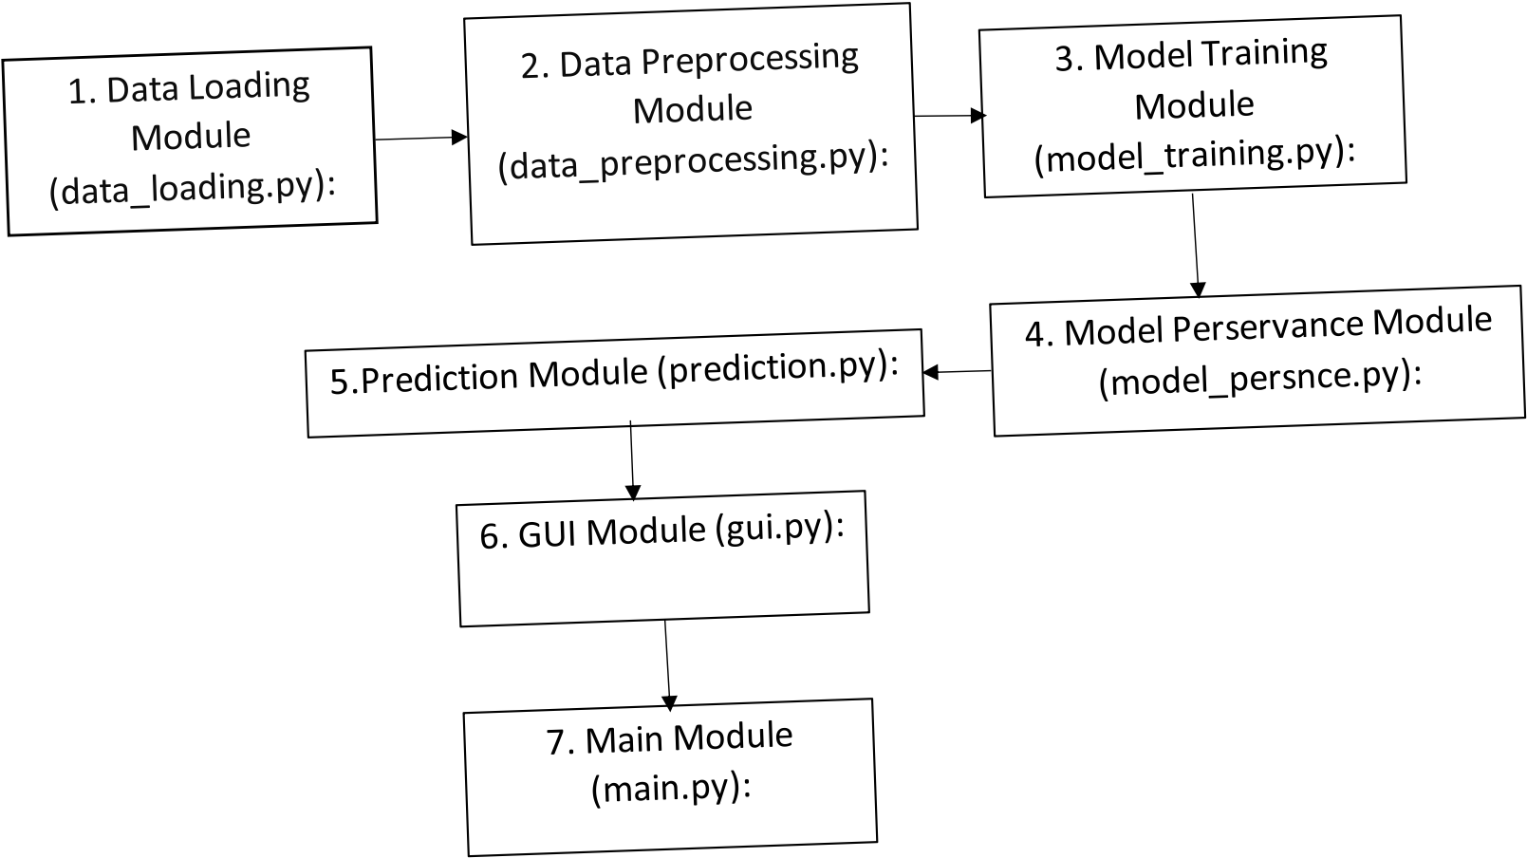
Application Modules

Slide 10
Implementation
These are simplified examples to give you an idea of how each module might be implemented. Depending on specific requirements and the libraries we choose, may need to adjust these code snippets.
Github: https://github.com/MokshithT/LoanApprovalSystemML/blob/main/Loan%20Status%20Prediction%20Using%20Machine%20Learning.ipynb

Slide 11
System Models (UML Diagrams)

Slide 12
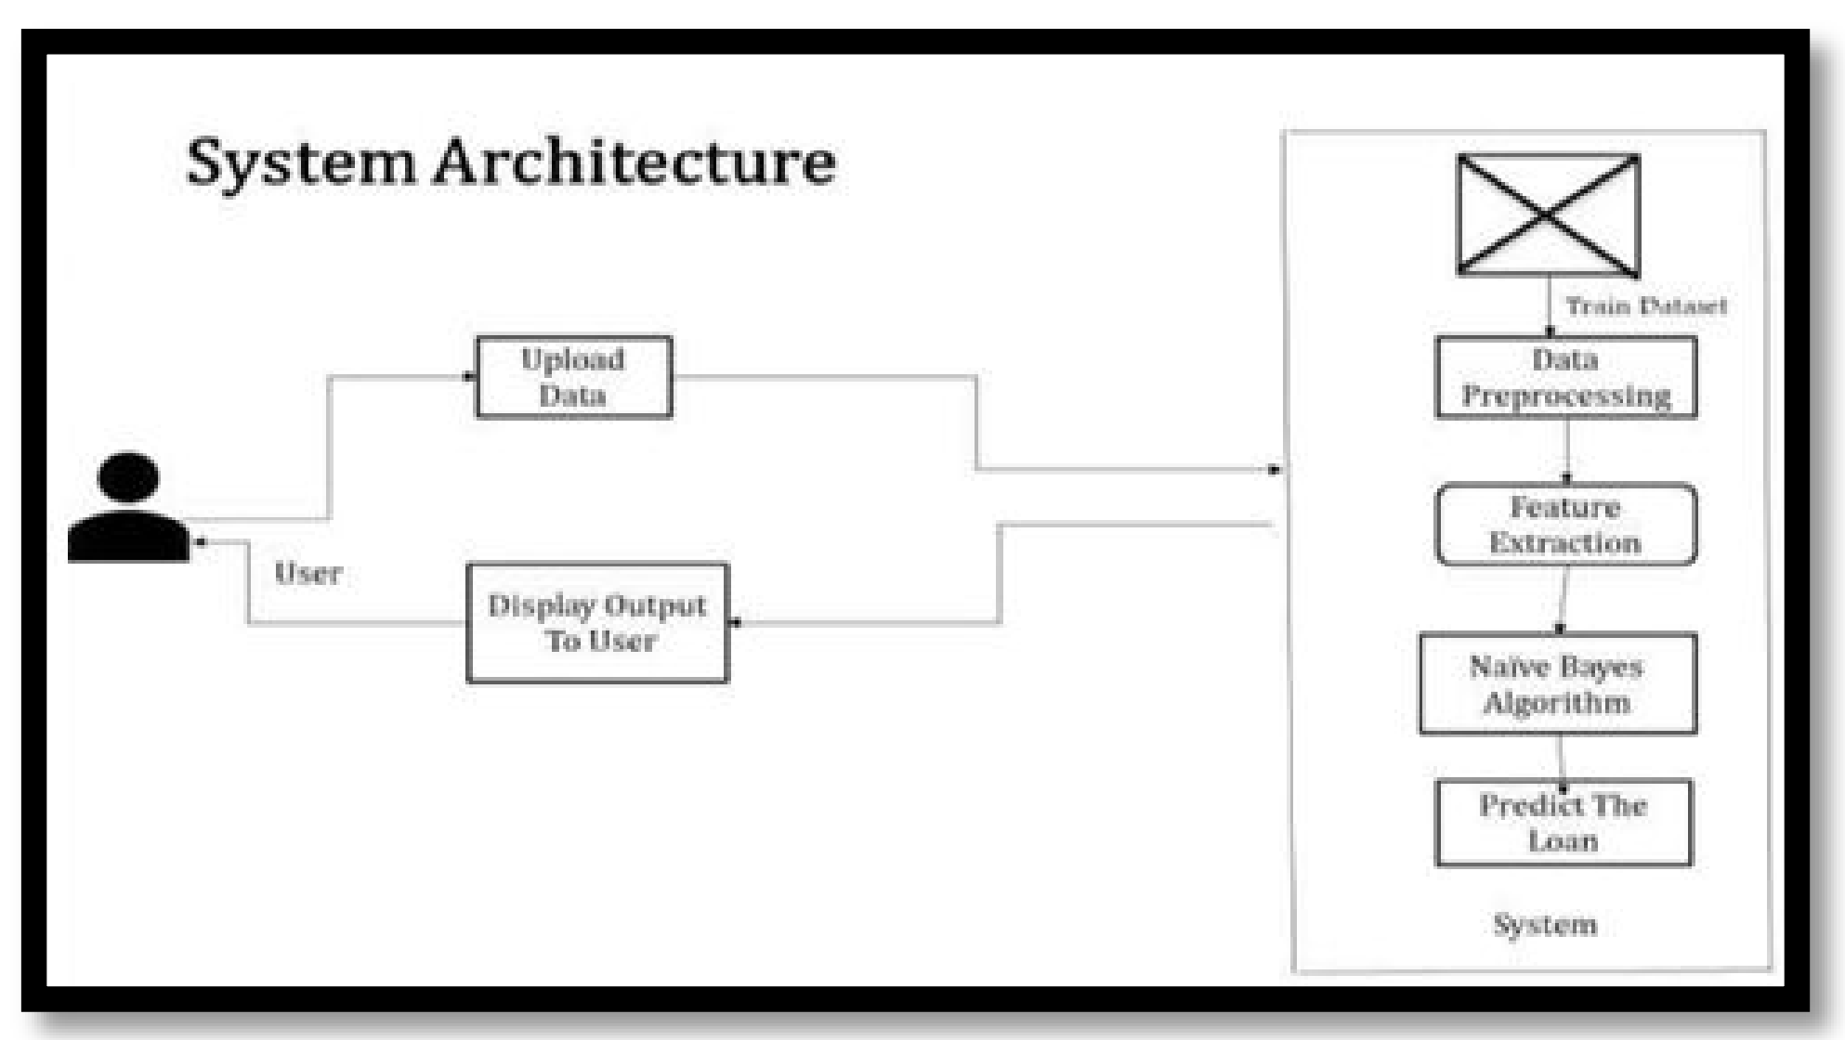
Dataflow Diagram

Slide 13
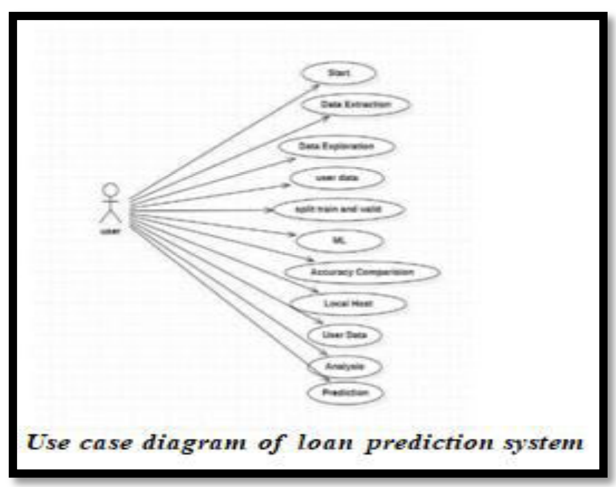
Use-Case Diagram

Slide 14
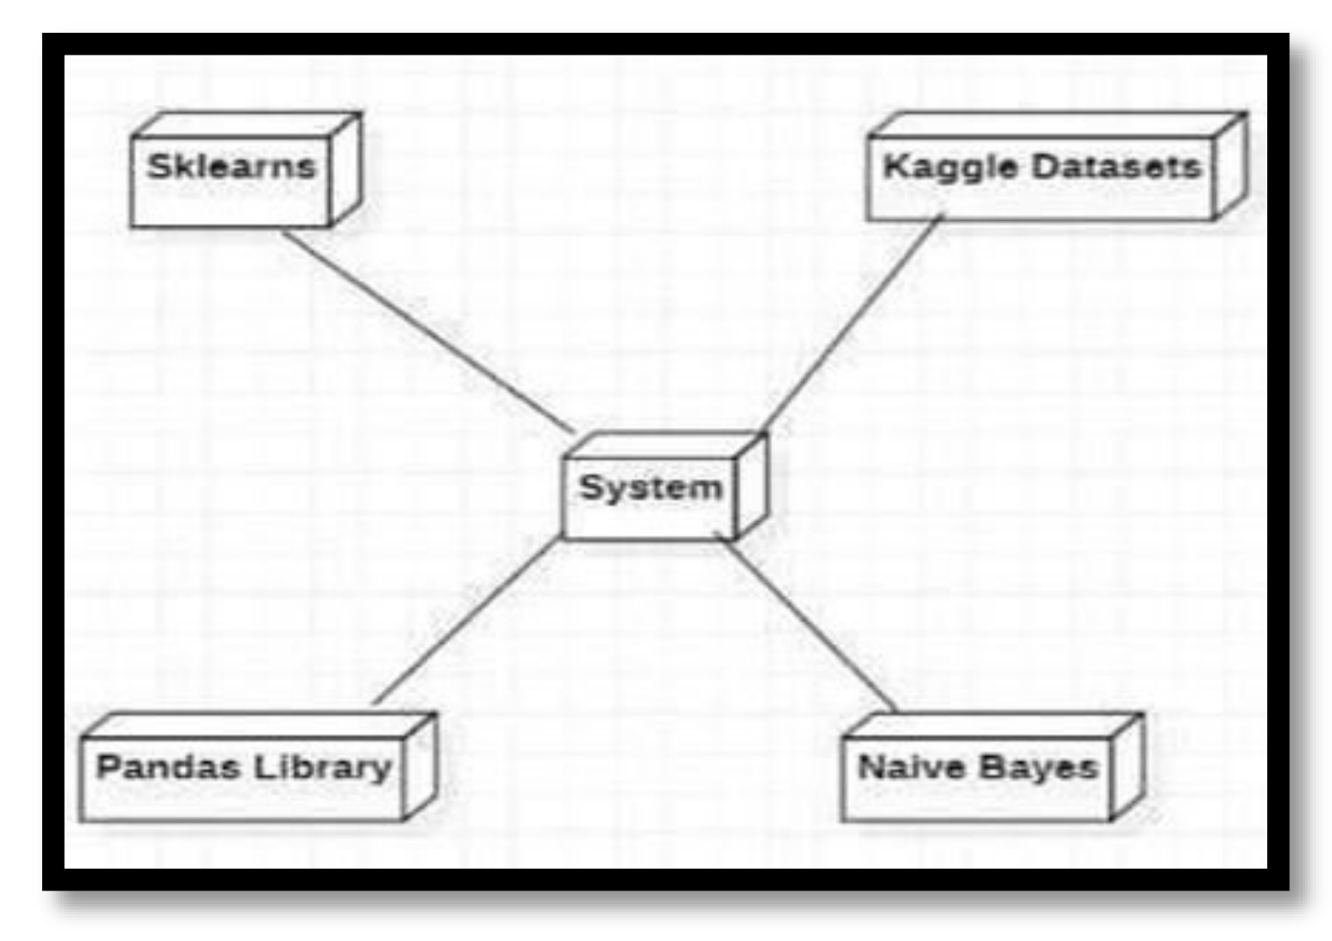
Sequential Diagram

Slide 15
Output Screens

Slide 16
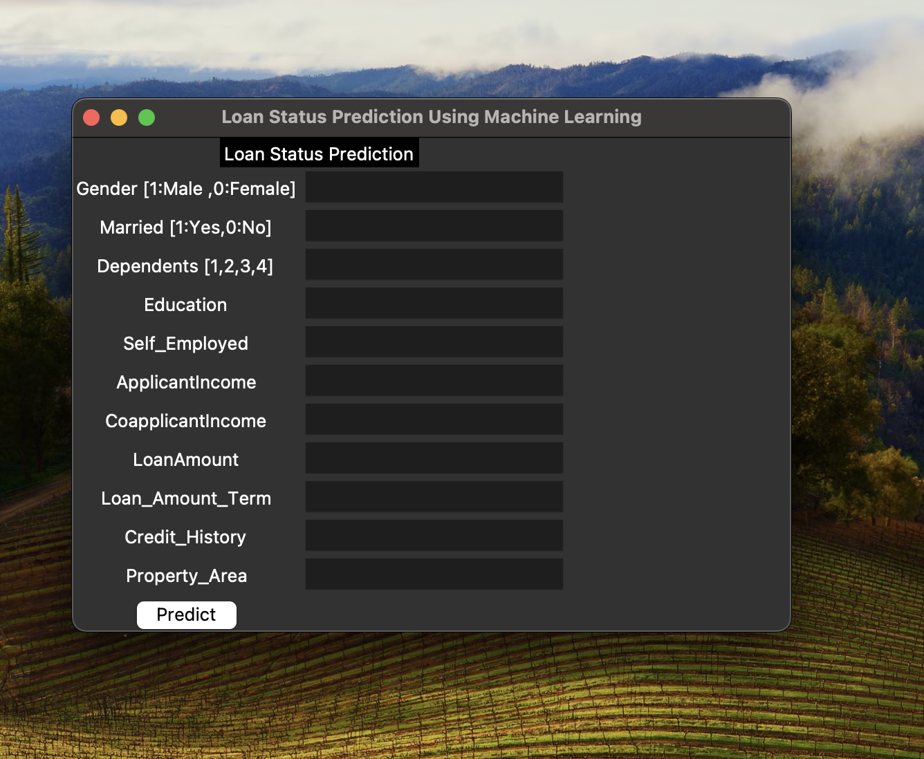
Results (Output Screens)

Slide 17
Conclusion & Future Scope

Slide 18
Conclusion
In conclusion, the Loan Status Prediction System demonstrates a comprehensive approach to predicting loan approval using machine learning.
Through modularization, the code is organized into distinct and purposeful modules, from data loading and preprocessing to model training, hyperparameter tuning, and a user-friendly GUI.
The Random Forest model, optimized through hyperparameter tuning, is employed for accurate predictions.
The application not only provides a robust backend for machine learning tasks but also offers a convenient GUI for users to input data and receive instant loan approval predictions.
This modular and well-structured system facilitates maintainability, scalability, and ease of integration into diverse applications.

Slide 19
Future Scope
The Loan Approval Prediction System using machine learning lays the foundation for a dynamic and evolving financial decision-making process.
Looking ahead, there are several avenues for future enhancement and expansion that can contribute to the system's continued effectiveness and relevance.
Firstly, the incorporation of additional features into the machine learning model can enhance its predictive capabilities.
Techniques like neural networks or gradient boosting may uncover complex patterns within the data that traditional models might overlook.
Regular updates to the model based on new data and retraining schedules can ensure that the system remains robust and aligned with real-world scenarios.

Slide 20
Thank you
S. Anvesh
T. Mokshith
V. Gouthami

